Slide 1
Friday, March 1, 2013
Agenda:
No TISK & No MM
Calculate the area of an equilateral triangle.
Calculate the area of a regular polygon.
Homework: Complete Ch10 Packet

Slide 2
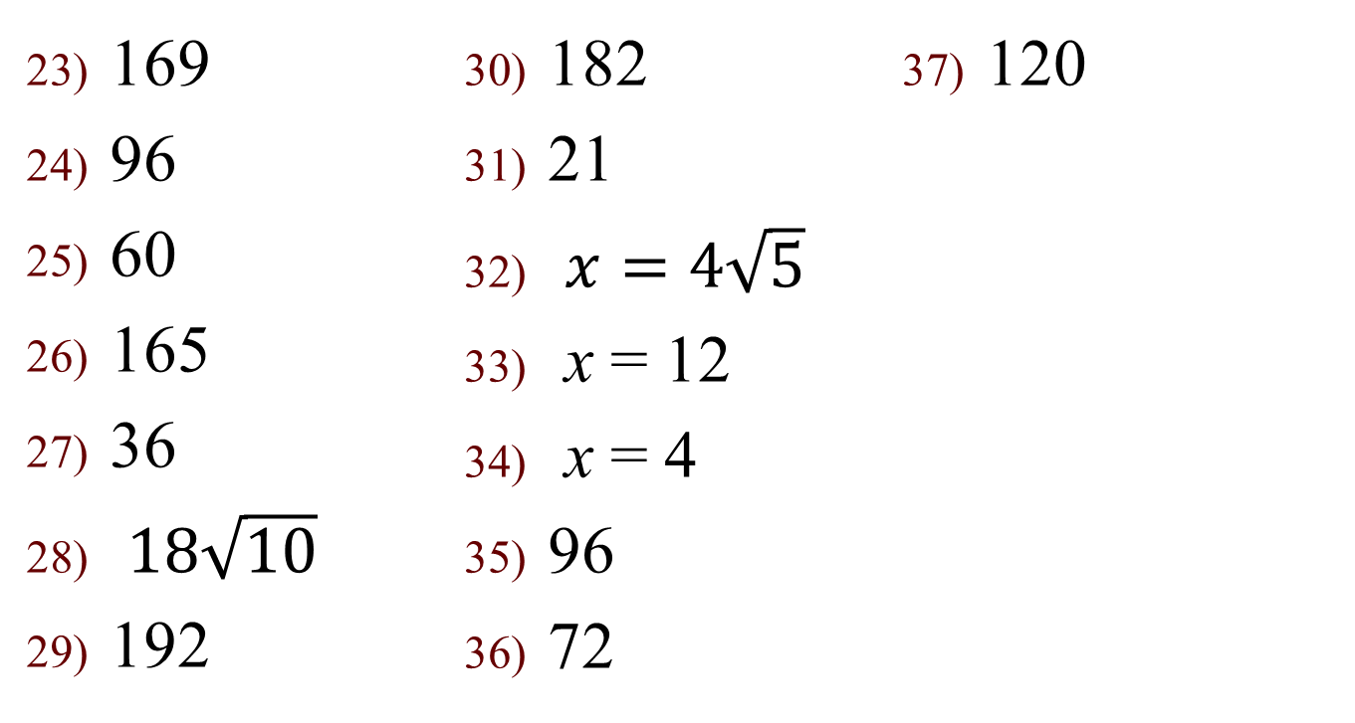
Homework Check
169
96
60
165
36
$18\sqrt{10}$
192
182
21
$x=4\sqrt{5}$
x = 12
x = 4
96
72
120

Slide 3
§10.5 Areas of Regular Polygons
Area of an Equilateral Triangle Theorem
  If the side of an equilateral triangle has length, s, then the area is:
s
s
s

Slide 4
Definitions
Center of a Polygon
  The center of the circle that circumscribes the polygon.
Radius of a Polygon
  The radius of the circle that circumscribes the polygon
Apothem of a Polygon
  Height of the triangle between the center and two consecutive vertices of a polygon

Slide 5
Area of a Regular Polygon Theorem
The area of a regular n-gon with side length s, apothem a, and perimeter P is:
or

Slide 6
Definition
Central Angle of a Regular Polygon
  An angle whose vertex is the center and whose sides contain two consecutive vertices of the polygon.
  The angle measure will always be 360º divided by n.
NOT a central angle
Central angle

Slide 7
Example.
Find the area of the regular dodecagon with radius of 8.3 feet and side length of 4.3 feet.
A dodecagon has 12 sides, so
To find the apothem, set up a triangle and draw in its height.
Find the central angle
4.3 ft
8.3 ft
The apothem is adjacent to the 15º angle, and the base is opposite the angle, so use the tangent to find the apothem.
2.15 ft
2.15 ft

Slide 8
2.15 ft
2.15 ft

Slide 9
YES!
You will need a calculator with the ability to calculate trig ratios for many of these.
You will use a calculator on the test for this chapter!

